Slide 1




Slide 2
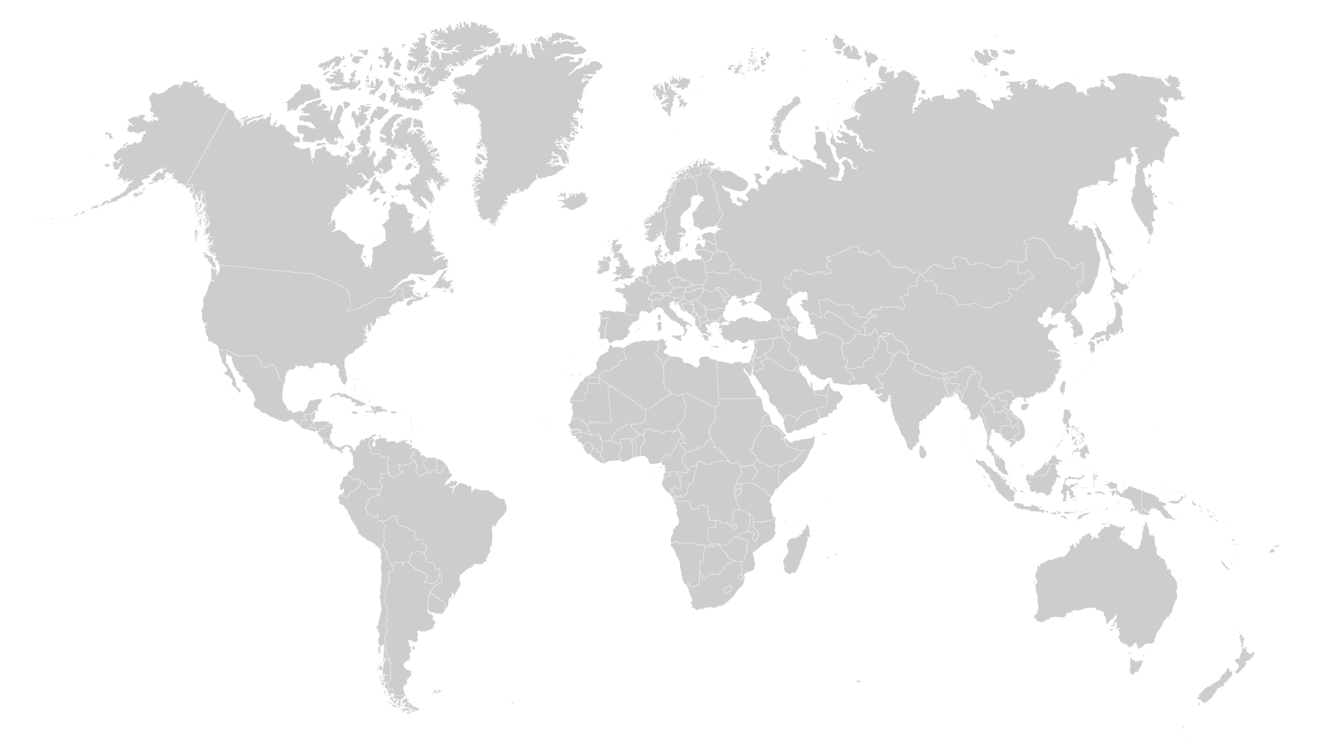

Slide 3



Headquarters & Company Branches

Slide 4
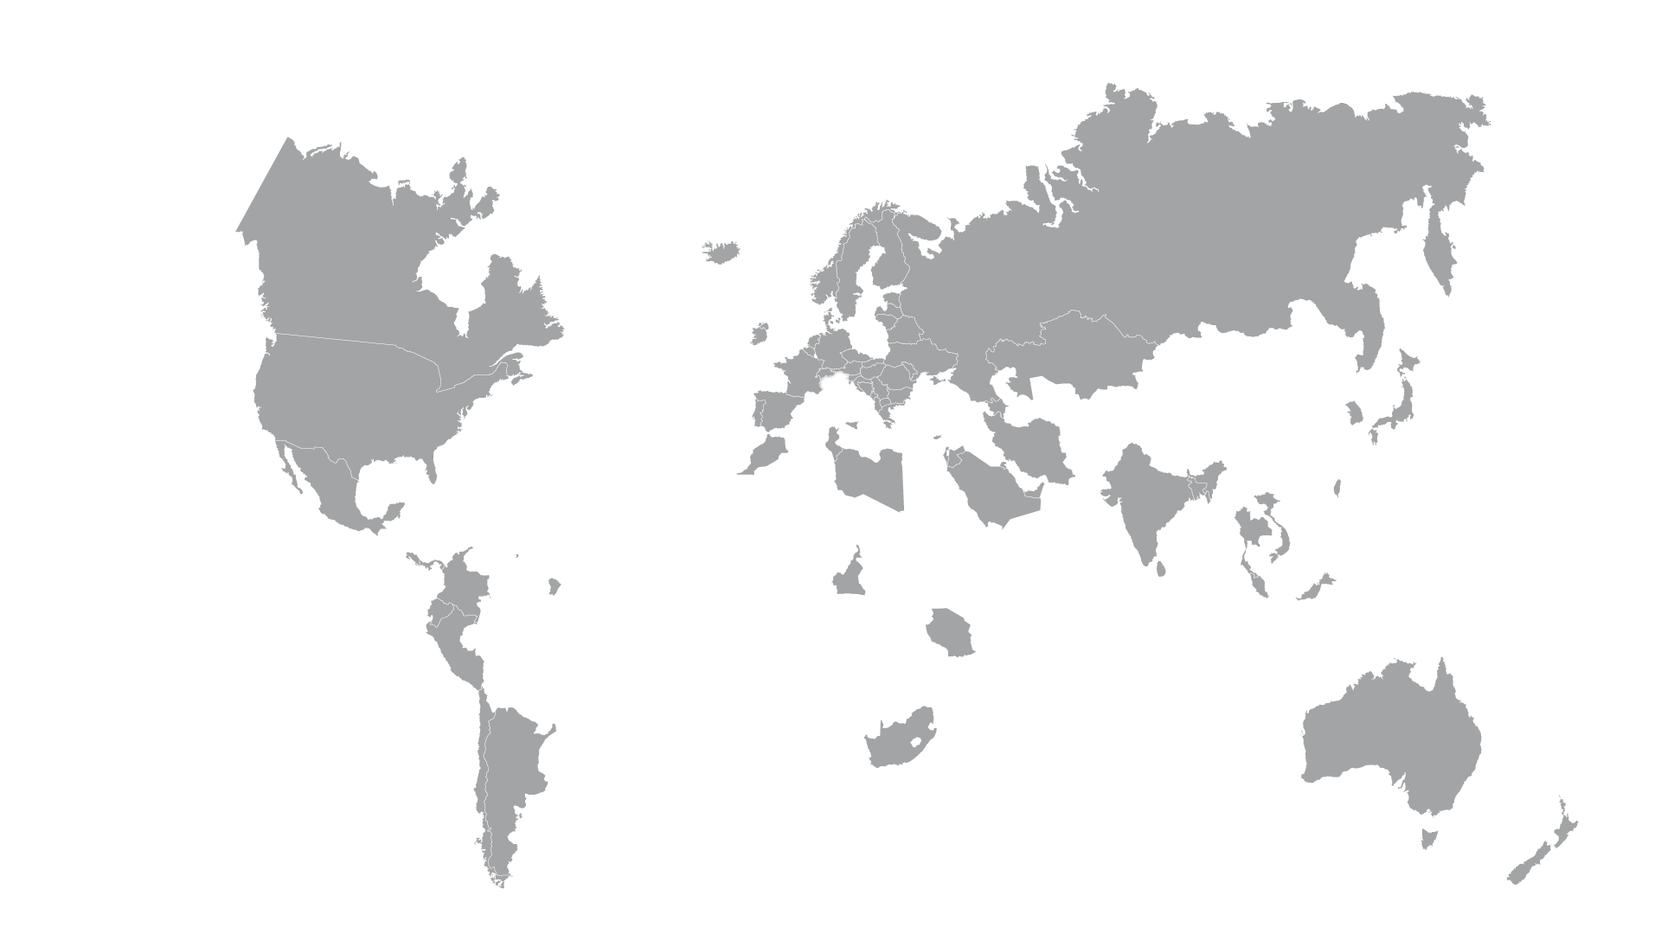
Headquarters & Company Branches
Our customers

Slide 5
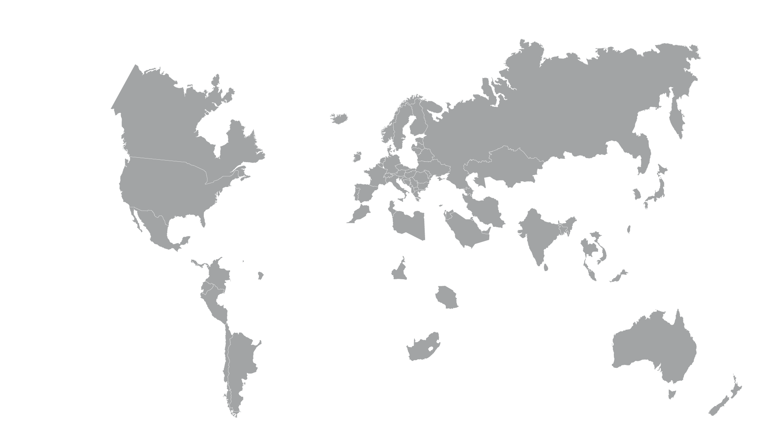


Headquarters
Sales Department
Production Plant
Headquarters & Company Branches
Our customers

Slide 6
Headquarters
Sales Department
Production Plant
Headquarters & Company Branches
Our customers

Slide 7
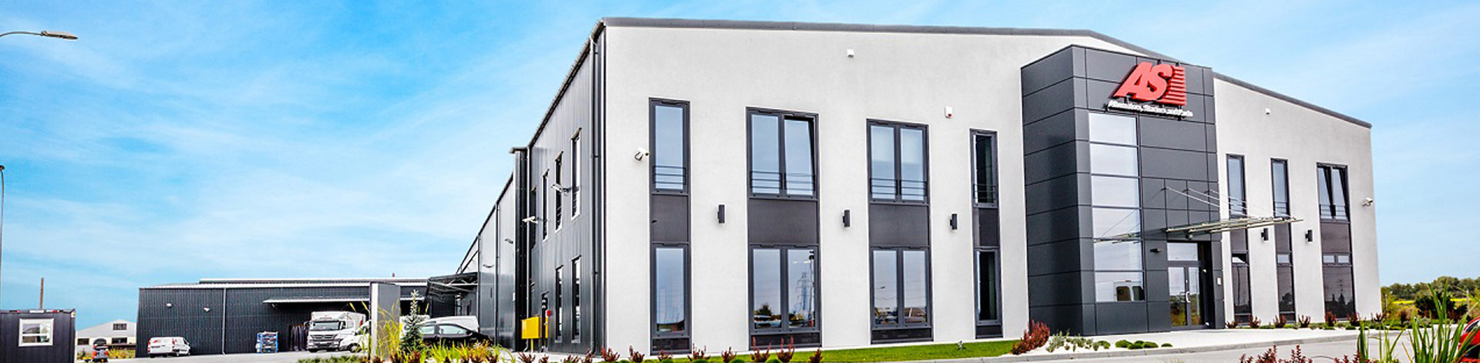





AS-PL MISSION
Products
Leader
29 years
„PROVIDING TOP-QUALITY GOODS TAILORED
TO MARKET EXPECTATIONS WHILE USING
STATE-OF-THE-ART TECHNOLOGIES”
OF PREMIUM
QUALITY
OF THE INDUSTRY
OF EXPERIENCE

Slide 8


Company’s establishment
The company was established in 1992
in Gdańsk under the name Auto-Starter
1992

Slide 9





2004
Creating of AS brand
Products of the own brand “AS” were introduced
Assembly in Poland
The assembly process of alternators
and starters is carried in Poland
2007
2013
New Headquarters
Opening of the Company's Headquarters
with warehouse space of 5000m² in Gdańsk
TecDoc
Joining the TecDoc catalogue under
the name AS-PL
2015
ISO certificate
Obtaining an ISO 9001certificate

Slide 10





Production Plant
The opening of a Production Plant
and warehouse space of 5000m²
2016
2017
AS-PL Sp. z o.o.
A change of the company’s name
to AS-PL Sp. z o.o
AS-PL UK Ltd.
The establishment of a new Company
on the British market
MAM AutoCat v8
Joining to the British
MAM AutoCat v8 catalogue
2018
Sales Department
The new office and a warehouse
with the total space of 3000m²

Slide 11


2019
Groupauto Poland
The official supplier of the Groupauto Poland purchasing group for the largest domestic car parts distributor
AS-PL Italia s.r.l.
the opening of a new
Branch Office in Italy

Slide 12
AS-PL IN FIGURES

Slide 13
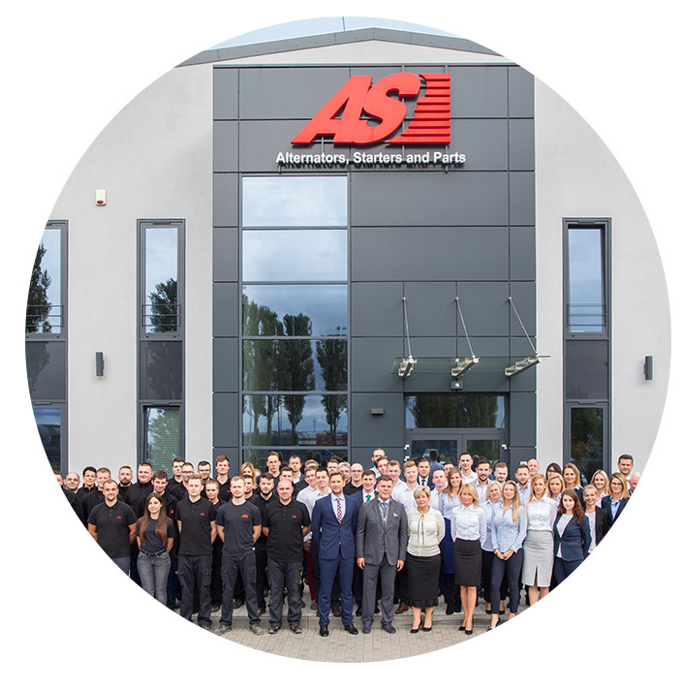
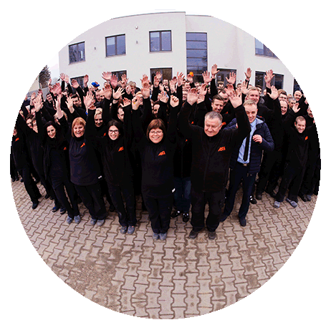
AS-PL IN FIGURES
EMPLOYMENT IN AS-PL
OVER THE YEARS

Slide 14
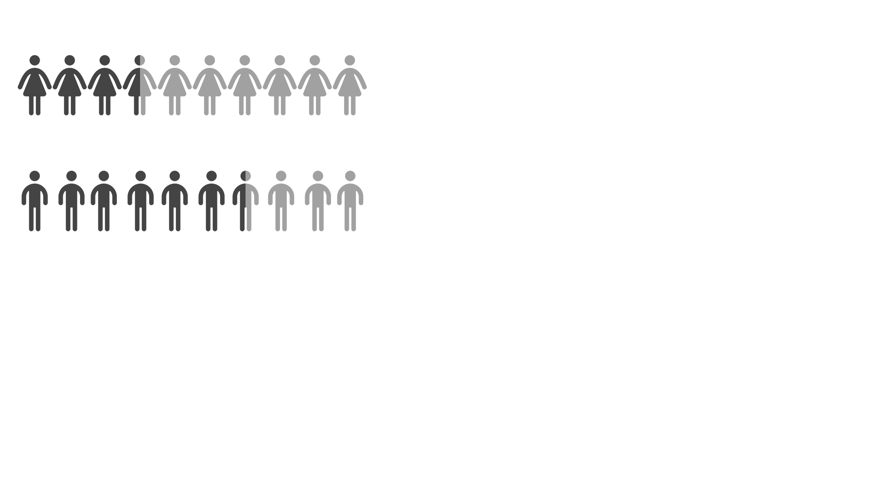
AS-PL IN FIGURES
EMPLOYMENT IN AS-PL
OVER THE YEARS
Headquarters
298
employees
Production Plant
Sales Department
35%
65%

Slide 15
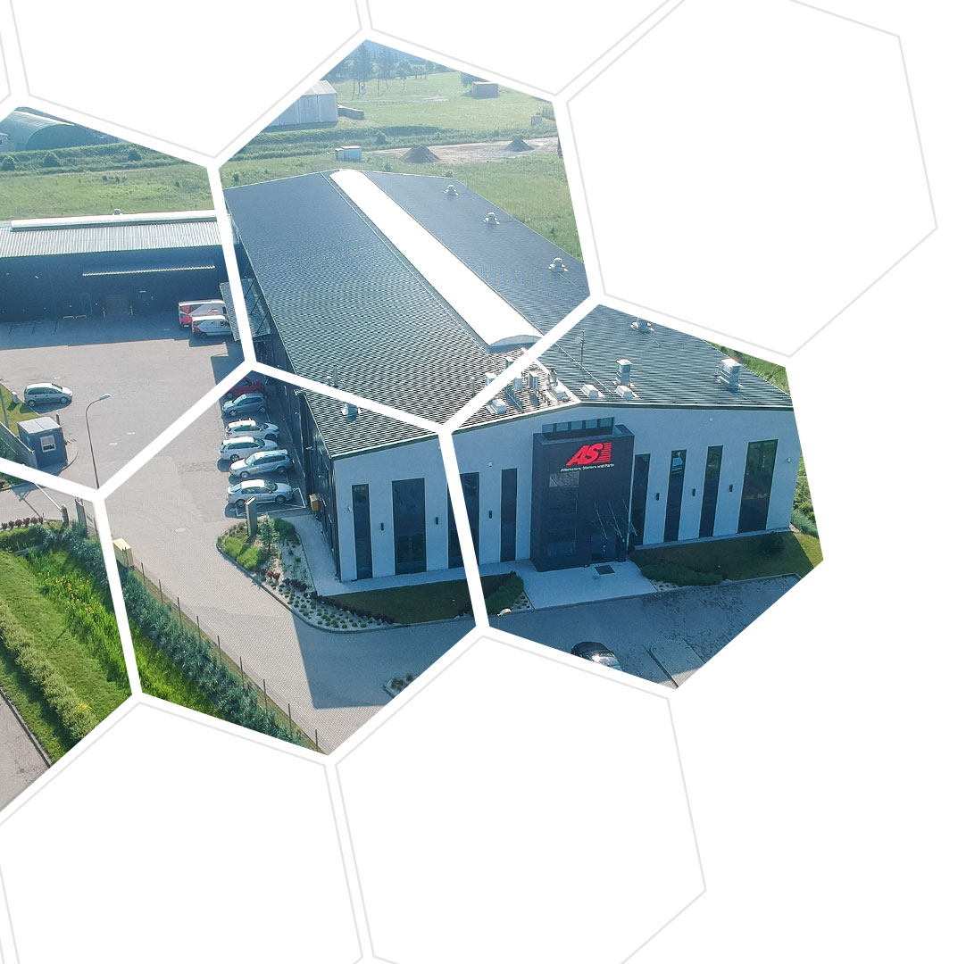
AS-PL IN FIGURES
WAREHOUSE SPACE
OVER THE YEARS

Slide 16

WAREHOUSE SPACE
OVER THE YEARS
AS-PL IN FIGURES
Italy
Headquarters
Production Plant
14 000sqm
of warehouse space
Sales Department

Slide 17
WAREHOUSE SPACE
OVER THE YEARS
AS-PL IN FIGURES
Italy
Headquarters
Production Plant
14 000sqm
of warehouse space
Sales Department
14 500
12 500
65 000
PALLET
PLACES
COMPLETED ORDERS
PER MONTH
DIFFERENT PRODUCTS
PACKED PER DAY

Slide 18
COMPANY OFFER

Slide 19
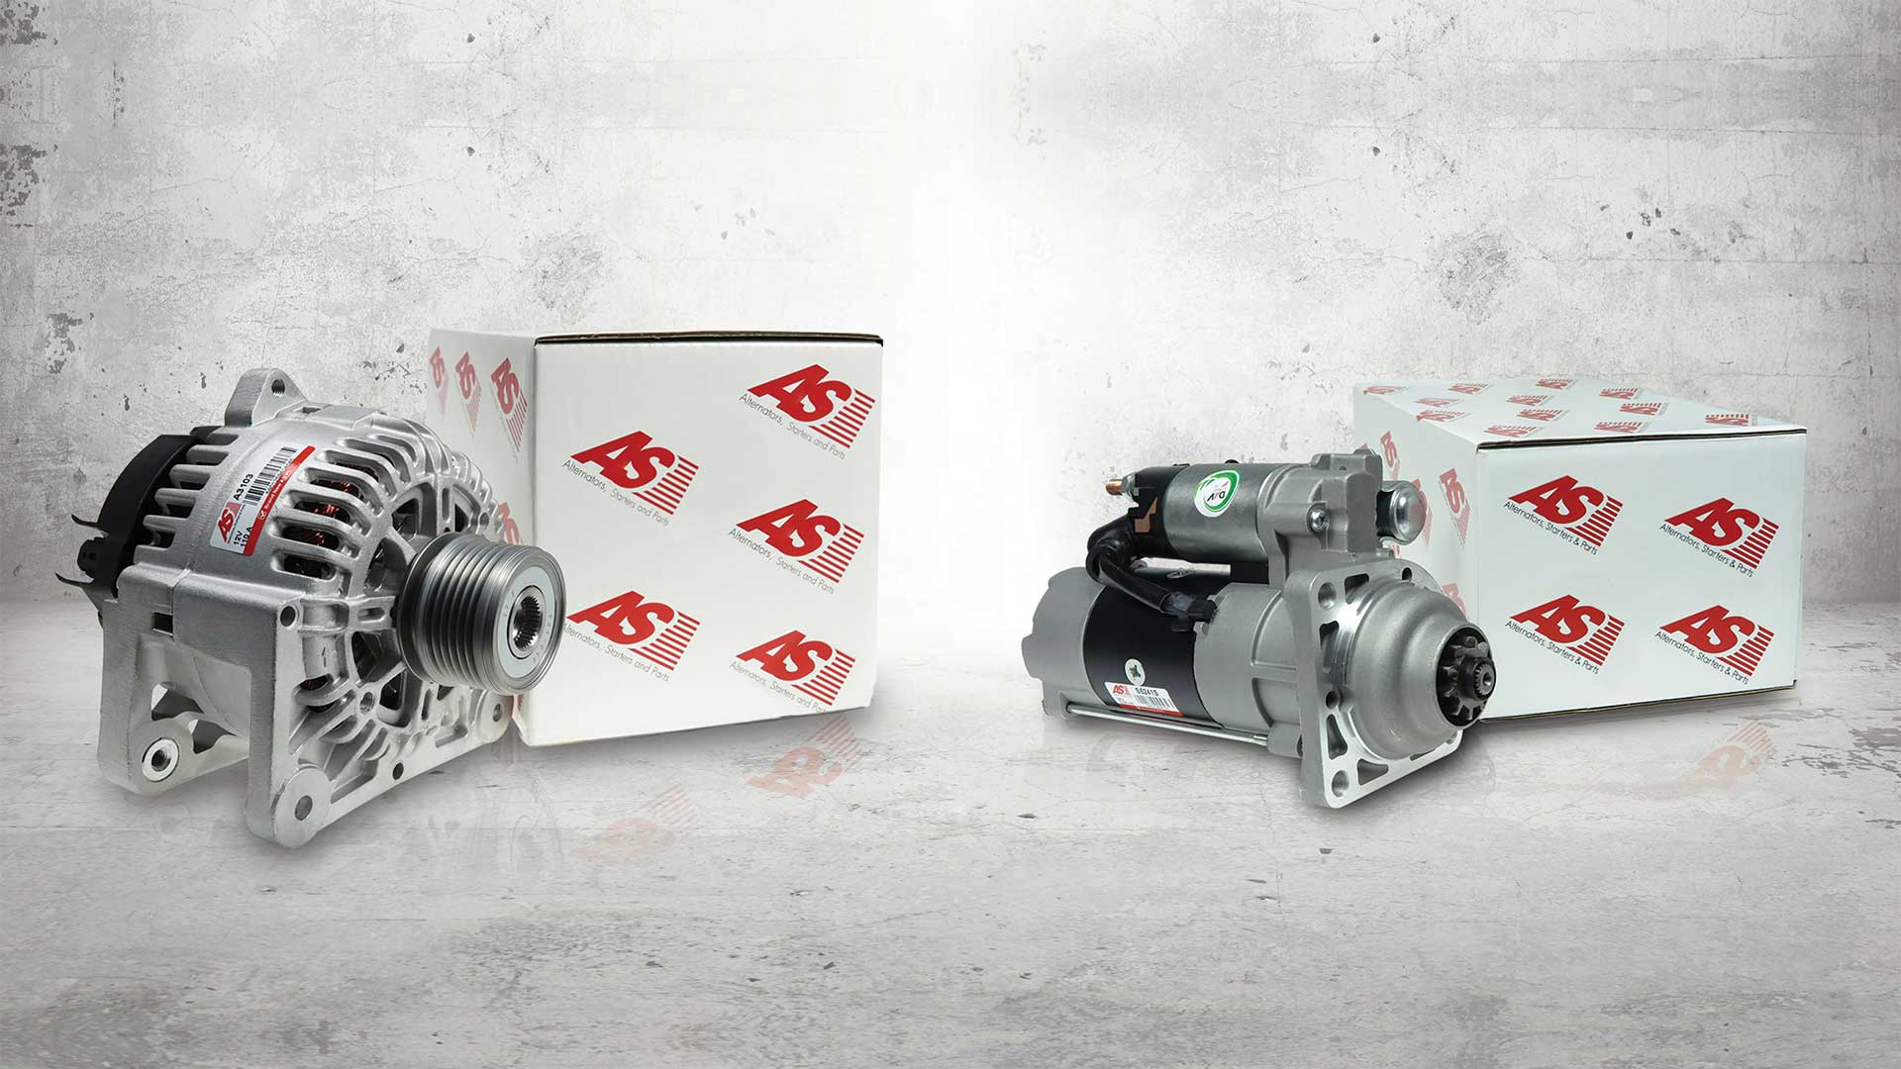

Slide 20
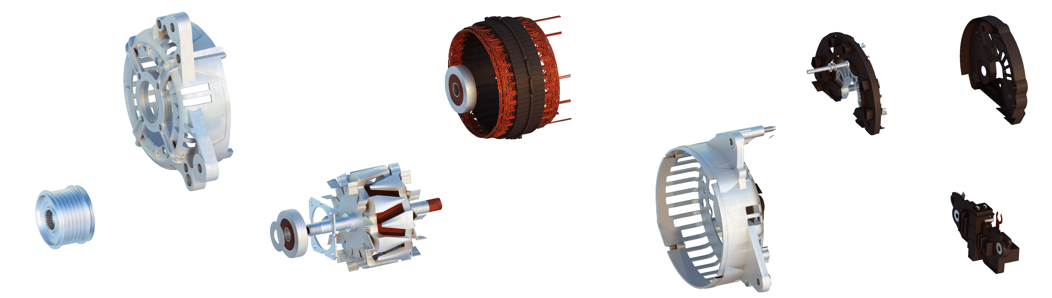

COMPANY OFFER
ALTERNATOR
AS-PL offers more than 3.400 types of alternators for various vehicles: passenger cars, lorries, agricultural machines, boats, motorcycles, and for the industrial market. Such a wide selection of products enabled the company to become one of the leading suppliers in the worldwide spare parts industry.

Slide 21
OFERTA FIRMY
COMPANY OFFER

Slide 22
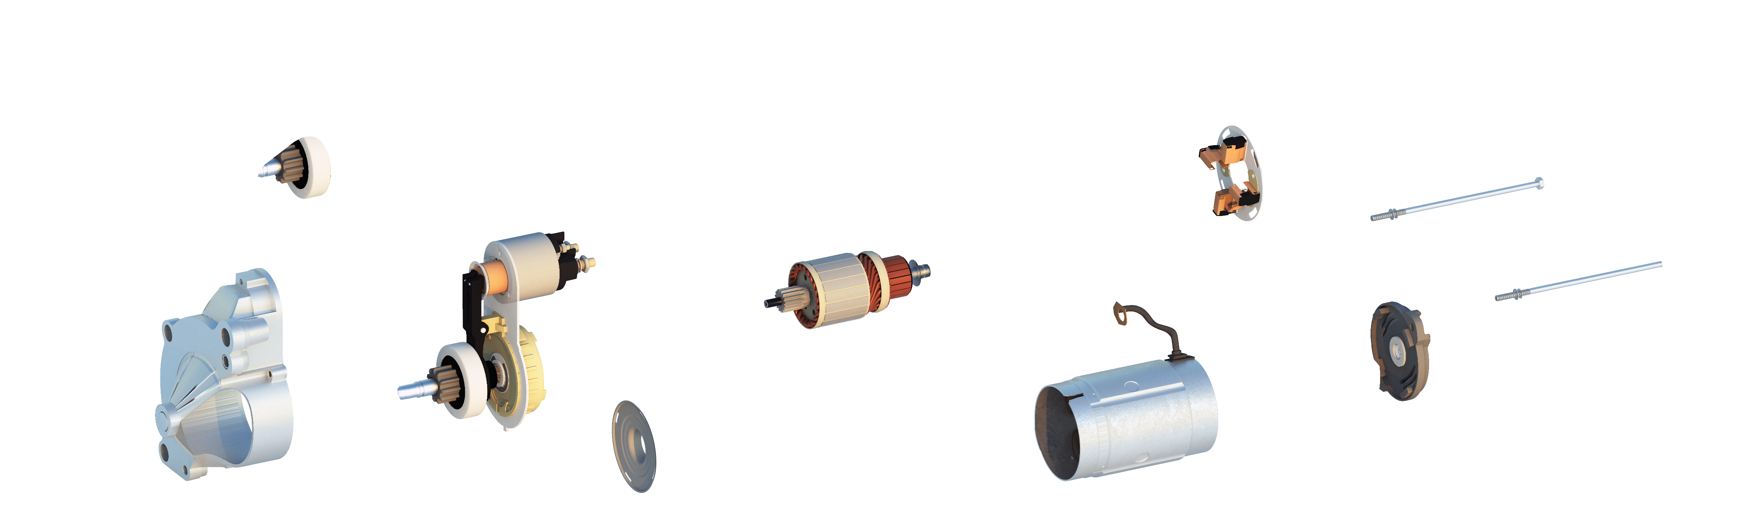

OFERTA FIRMY
COMPANY OFFER
STARTER
AS-PL offers more than 3.000 types of starters for passenger cars, lorries, agricultural machines, boats, motorcycles, and for the industrial market.

Slide 23
OFERTA FIRMY
COMPANY OFFER

Slide 24
COMPANY OFFER
AS-PL offers more than 13.600 parts and components for various vehicles: passenger cars, lorries, agricultural machines, boats, motorcycles, and for the industrial market. The components are divided into assortment groups.

Slide 25
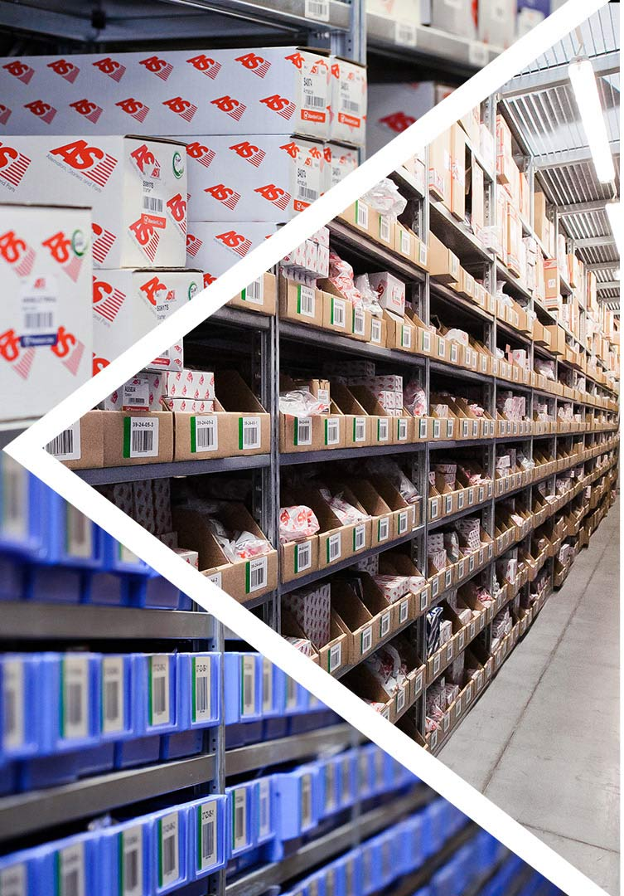
COMPANY OFFER
Alternators
Parts for alternators and starters
20 000
of assortment items in total*
Starters
*Available in a constant offer

Slide 26

COMPANY OFFER
AS-PL product lines:
Parts for alternators and starters
Alternators
- the option addressed to the customers who are looking for the best quality. Products supplied by world-class OEM (Original Equipment Manufacturer) manufacturers and selected products of AS brand.
20 000
of assortment items in total*
Starters
- the leading product line of the AS brand, option directed to the customers looking for high quality and reliable products at a competitive prices.
- the line of products that merge the
quality at a reasonable price.
*Available in a constant offer

Slide 27
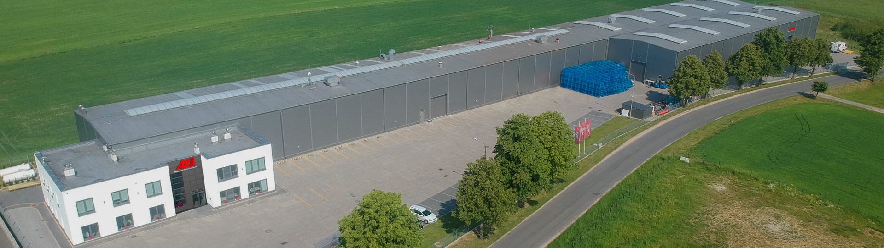

AS-PL
PRODUCTION
PLANT
More than
20 000
More than
15 000
100%
Starters
produced per month
Alternators
produced per month
Products
tested

Slide 28
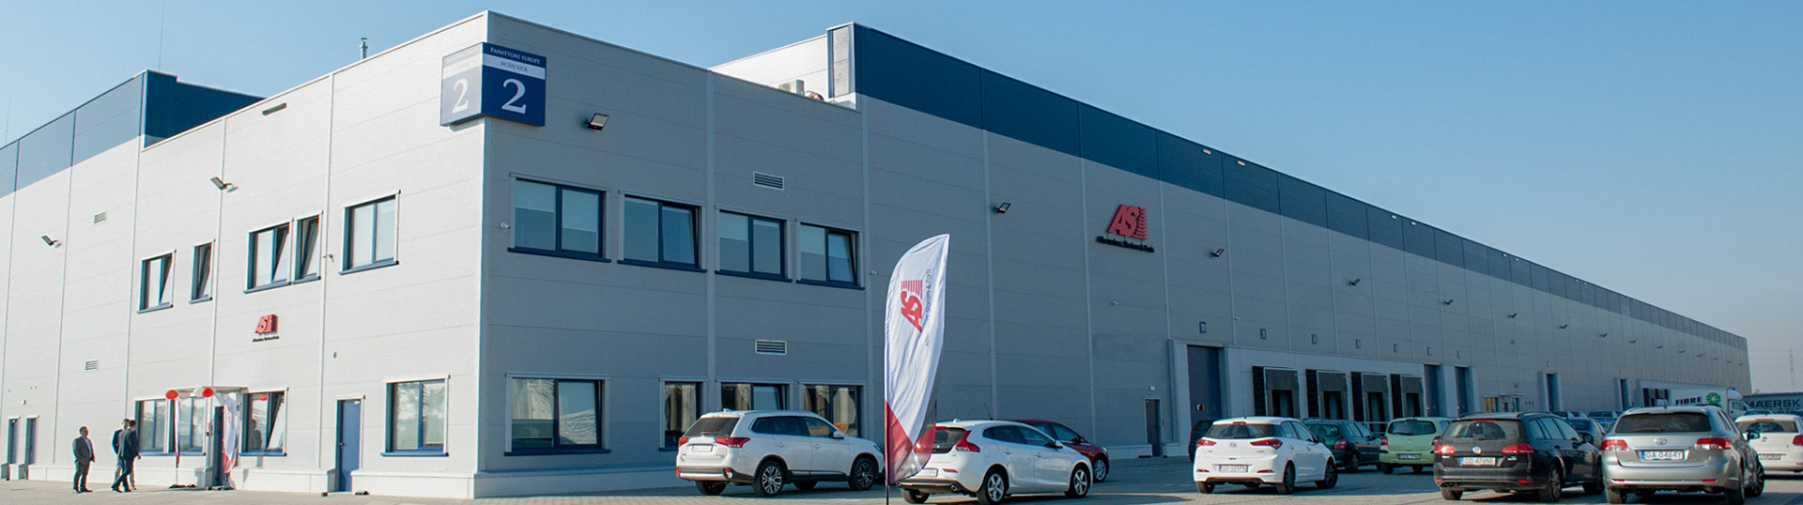
More than
20
About
100
More than
20%
Sales
Specialists
Directions of
AS-PL export globally
Average annual
increase in sales
AS-PL
SALES
DEPARTMENT

Slide 29

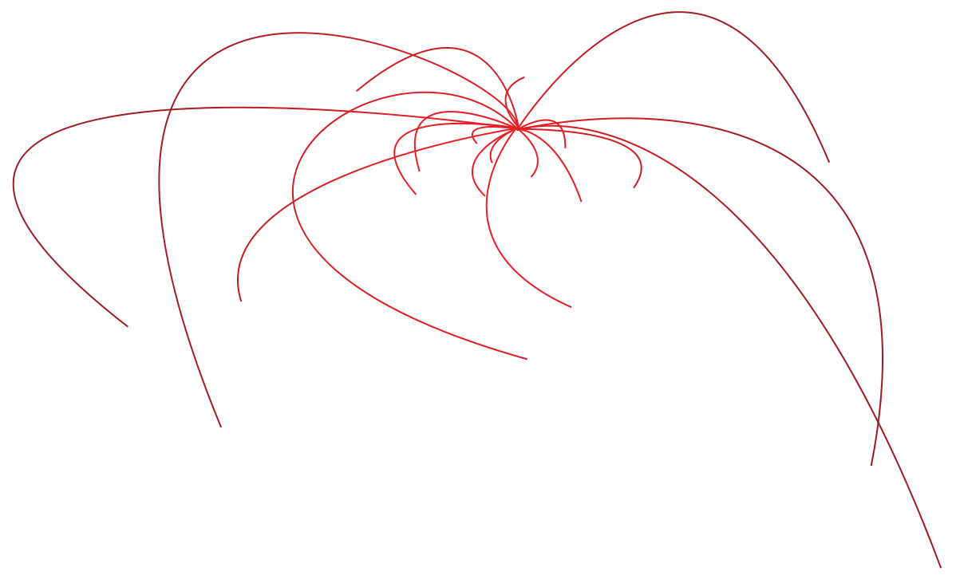


Slide 30
SALES RESULTS
INCREASE IN SALES
OVER THE YEARS
40
mln EURO
Domestic
Export

Slide 31
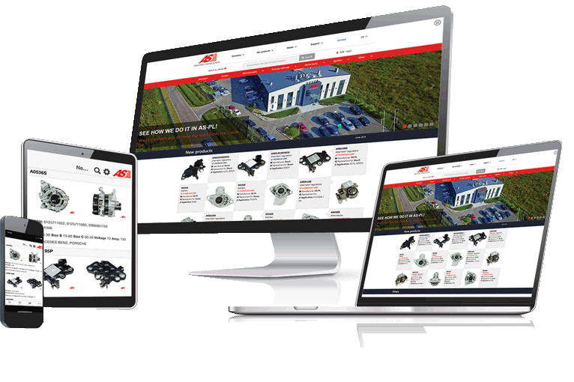
CATALOG ON-LINE
as-catalog.com
1
easy and quick product search
2
available 24/7
3
download on Google Play & App Store

Slide 32






E-CATALOGS & CERTIFICATES
TecDoc DATA SUPPLIER
e-catalog providing the current
scope of parts for the workshops
MAM AutoCat v8
e-collection of vehicle parts on the British market
TUV Rheinland ISO 9001:2015
a global leader in independent inspection services
EAC
confirmation of product compliance with
the standards within the Customs Union

Slide 33

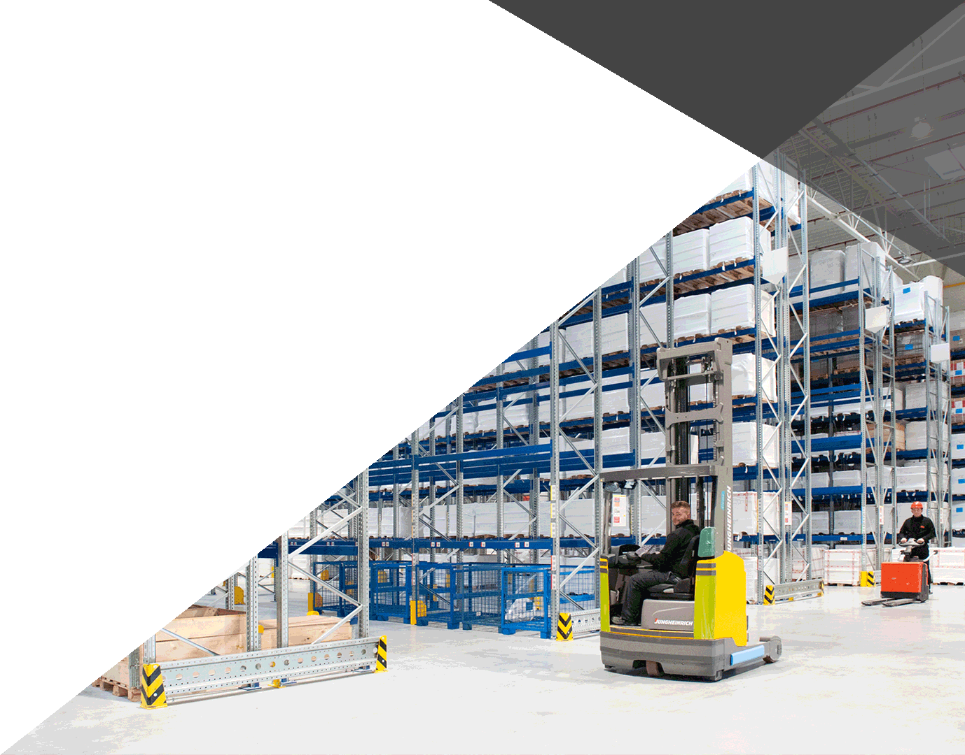





MEMBERSHIP
SDCM
Polish association operating
in the automotive sector
IAAF
a federation promoting
the market of spare parts in the UK
APRA
an association of companies on the remanufacturing of spare parts market

Slide 34
OUR CUSTOMERS

Slide 35
OUR CUSTOMERS

Slide 36

NASI KLIENCI
OUR CUSTOMERS

Slide 37

OUR CUSTOMERS

Slide 38

NASI KLIENCI
OUR CUSTOMERS

Slide 39

OUR CUSTOMERS

Slide 40

OUR CUSTOMERS

Slide 41

NASI KLIENCI
OUR CUSTOMERS

Slide 42

OUR CUSTOMERS

Slide 43

NASI KLIENCI
OUR CUSTOMERS

Slide 44

NASI KLIENCI
OUR CUSTOMERS

Slide 45

NASI KLIENCI
OUR CUSTOMERS

Slide 46

NASI KLIENCI
OUR CUSTOMERS

Slide 47

OUR CUSTOMERS

Slide 48

OUR CUSTOMERS

Slide 49

OUR CUSTOMERS

Slide 50

NASI KLIENCI
OUR CUSTOMERS

Slide 51

OUR CUSTOMERS

Slide 52

OUR CUSTOMERS

Slide 53
OUR CUSTOMERS

Slide 54

OUR CUSTOMERS

Slide 55

OUR CUSTOMERS

Slide 56

NASI KLIENCI
OUR CUSTOMERS

Slide 57


AS-PL AT THE FAIRS
TTM Poznań/ProfiAuto Show – Poland
Automec Sao Paulo – Brasil
Autopromotec Bologna – Italy
ReMaTec Amsterdam – Netherlands
Equip Auto Paris – France
Automechanika Frankfurt – Germany
MIMS Automechanika Moscow – Russia
Automechanika Birmingham – UK
Automechanika Johannesburg – South Africa

Slide 58
COMPETITIVE ADVANTAGES OF AS-PL

Slide 59
29 YEARS
OF EXPERIENCE
LEADER IN
THE INDUSTRY
100%
MADE
IN EU
COMPETITIVE
ADVANTAGES
OF AS-PL
100%
PRODUCTS
TESTED
CATALOG
ON-LINE
2 YEARS
WARRANTY
GLOBAL
RANGE
OWN „AS”
BRAND

Slide 60
AS-PL IN SOCIAL MEDIA

Slide 61
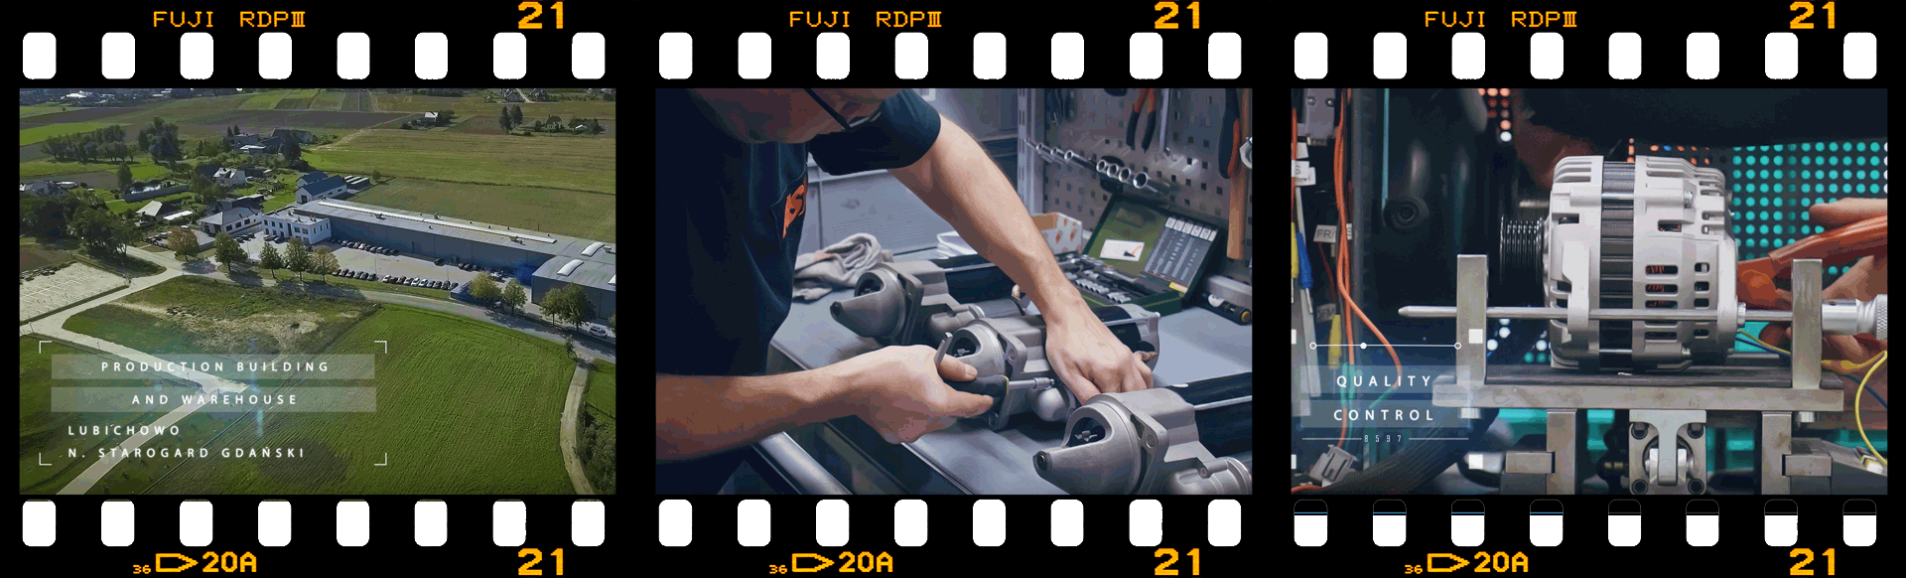
AS-PL IN SOCIAL MEDIA
Corporate movie
See how we do it in AS-PL!
Available on the YouTube channel - asplcom

Slide 62

AS-PL IN SOCIAL MEDIA
ALTER-nator Love Story
The humorous story of ALTER-nator and his buddy in the never-ending automotive Love Story, which gained over 1,600,000 views.
Available on the YouTube channel - asplcom

Slide 63




AS-PL IN SOCIAL MEDIA

Slide 64

AS-PL IN SOCIAL MEDIA
AS-PL IN SOCIAL MEDIA

Slide 65

AS-PL IN SOCIAL MEDIA

Slide 66

AS-PL IN SOCIAL MEDIA

Slide 67

AS-PL IN SOCIAL MEDIA
/asplcom

Slide 68
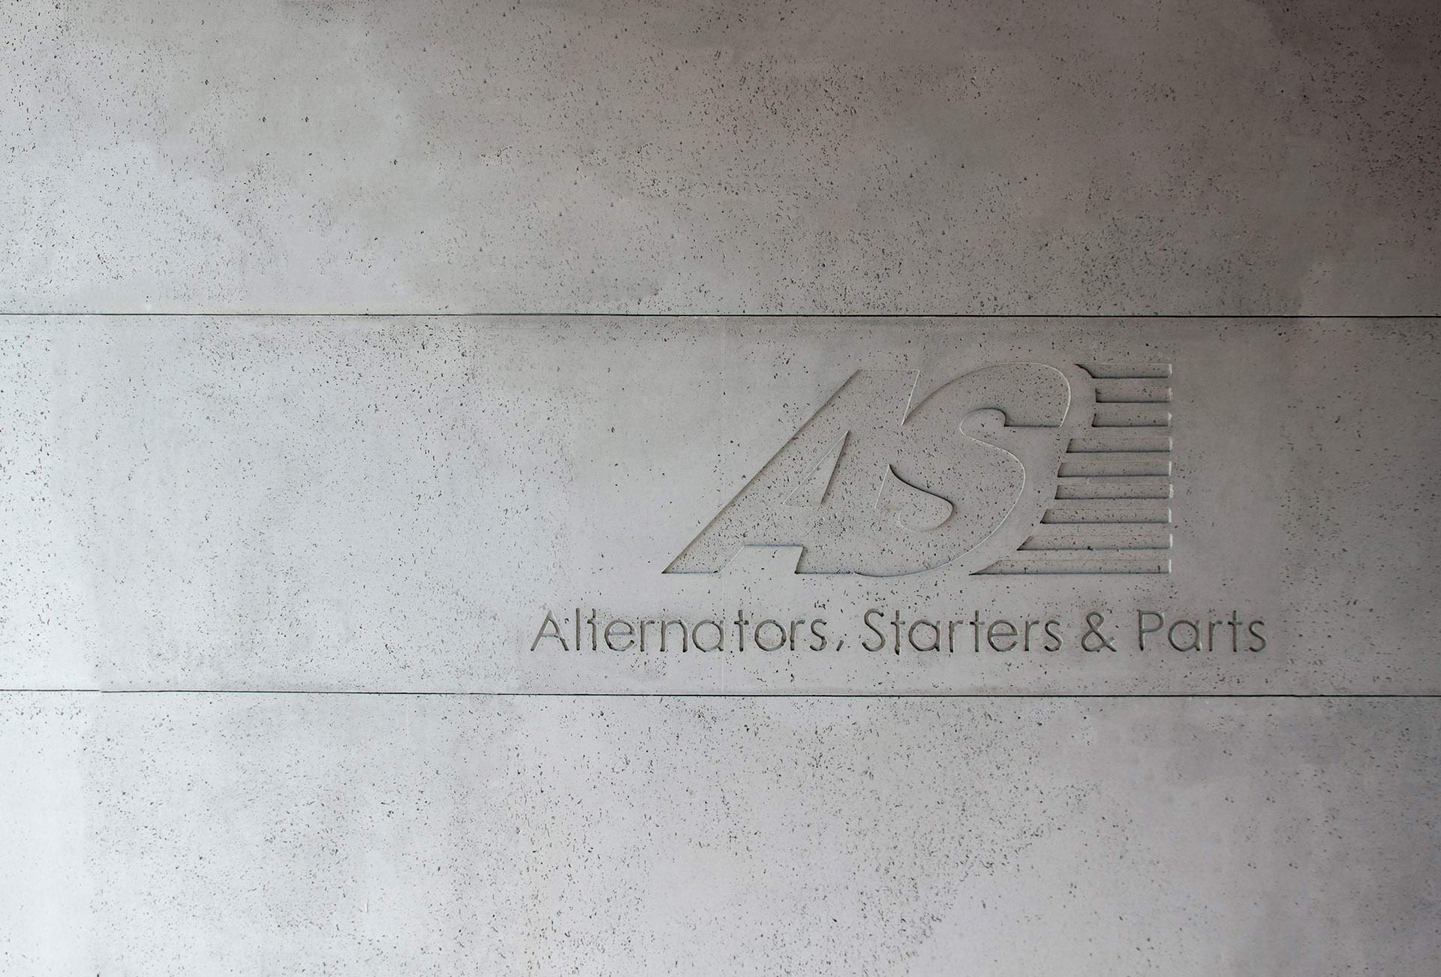



CONTACT
ul. Michałki 32
80-716 Gdańsk, Poland
Tel. (+48) 58 304 12 85
Fax. (+48) 58 304 13 77
info@as-pl.com
as-pl.com

Slide 69
© 2021 AS-PL Sp. z o.o.
All copyrights reserved. Reproduction of a part or all of the contents of this document without the prior written permission of the copyright owner is prohibited. The information included in this document is not an offer
or a contract in any form. They are deemed as genuine and can be changed without notification. The publisher shall not bear responsibility for any consequences resulting from the use of this information.

